Slide 1

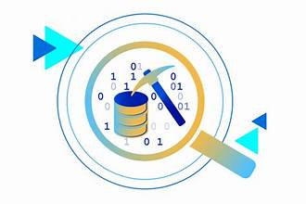
Louvain vs. Label Propagation
Thomas Eden, Nathan Ferguson, Erick Luna
COMP-5130: Data Mining - Fall 2025

Slide 2
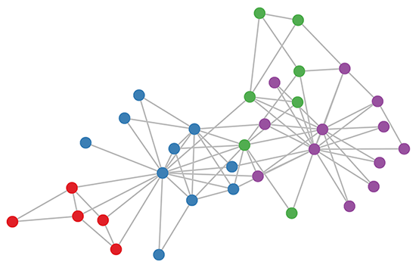
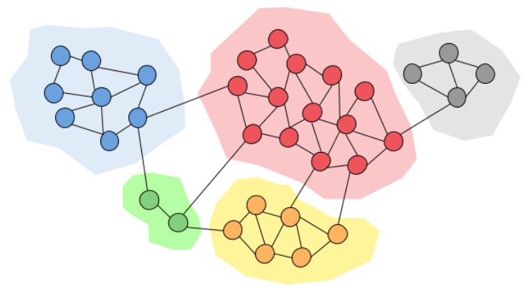
Community Detection
Community detection is a graph-based clustering method used to identify subgroups of nodes that tend to have stronger connections than the rest of the network. It is seen as an unsupervised learning process because this algorithm needs to discover hidden clusters of unlabelled data without using any pre-assigned labels.

Slide 3
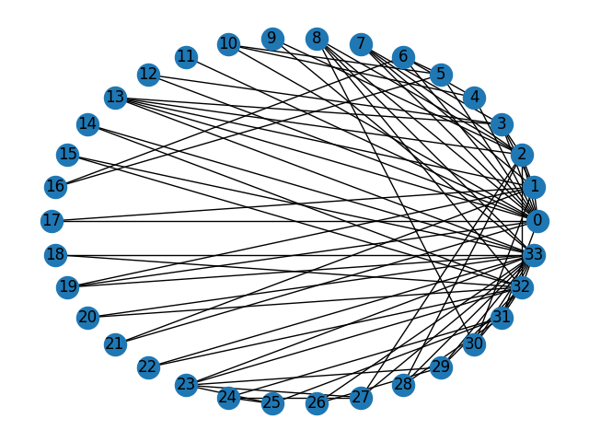
Karate Club Graph
The Karate Club graph (also known as Zachary’s Karate Club) is a standard network dataset that was studied by Wayne W. Zachary from 1970 to 1972. It consists of 34 nodes that represent members of a karate club and 78 edges that represent the interactions between members. The karate club eventually split into two opposing groups: Mr. Hi vs. Officer. These groups serve as real-world ground-truth communities, and due to its structure and size, it is a well-known dataset that has been used to test community detection algorithms such as Louvain and Label Propagation.
https://networkx.org/documentation/stable/auto_examples/graph/plot_karate_club.html

Slide 4

Louvain Algorithm
The Louvain algorithm is a modularity-based method that is used for community detection. It starts by placing each node into a community that best increases the modularity of the network. Then, these communities are grouped into super nodes. This process is repeated until modularity stops improving. Louvain is a commonly used algorithm because of its fast and scalable ability to make partitions with high modularity scores.

Slide 5
Label Propagation Algorithm
The Label Propagation algorithm (LPA) is a fast method used for community detection. Each node starts with a unique label, and in each iteration, nodes change their label to match the most common label from their neighbors. As labels spread (propagate) throughout the graph, strong connections are formed between groups of nodes with the same label. This process is repeated until all labels are stabilized. LPA is a commonly used algorithm because it doesn’t need an optimization function, which makes the model run quickly and be able to handle large graphs of data.

Slide 6
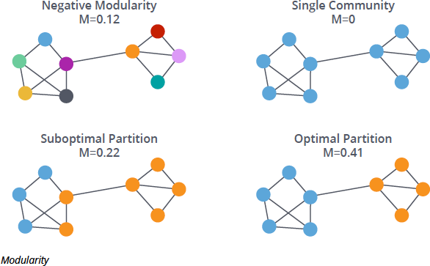
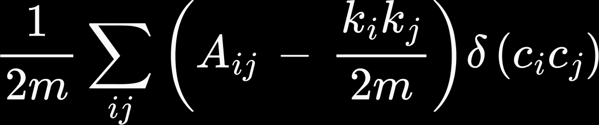
Modularity
Modularity (Q) is a measure of how well a network is partitioned into communities. It does this by comparing the actual edges in a community to the expected edges in the community if the edges were random. The higher the modularity the more dense the inside of communities are but the more spare each community is form another one.
The function for Modularity(Q) is :
Q =
Essentially the function takes the summation of all pairs in the graph (A_{ij} which is the observed connection (1 if an edge exist between i and j and zero otherwise). Then take the difference of the actual edge and the expected connections if the edges were random. The summation is then divided by total edges to normalize. The Kronecker delta ensures that only two edges in the same community add to the total modularity. It is a piecewise function that is 1 if i and j are in the same community and 0 otherwise.

Slide 7
Normalized Mutual Information (NMI)
Normalization of the Mutual Information score
Computes similarities between two independent label assignments
Uses true and predicted (pred) parameters
Results are stored in float values between 0.0 and 1.0 (0.0 meaning no mutual information and 1.0 meaning perfect correlation)
https://scikit-learn.org/stable/modules/generated/sklearn.metrics.normalized_mutual_info_score.html

Slide 8
Adjusted Rand Index (ARI)
Computes how similar two clusters are by counting paired samples
Uses true and predicted (pred) parameters
Results are stored in float values between -0.5 and 1.0 (0.0 meaning random labelling, 1.0 meaning identical clusters, and -0.5 meaning conflicting with communities)
https://scikit-learn.org/stable/modules/generated/sklearn.metrics.adjusted_rand_score.html

Slide 9

Code Demonstration

Slide 10

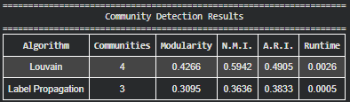
Observations
Louvain Algorithm (Part 2)
Label Propagation Algorithm (Part 2)
4 communities
Slower execution time
Higher modularity results
More evenly distributed clusters
Higher NMI and ARI values
3 communities
Faster execution time
Lower modularity results
Bigger cluster sizes and one small cluster of 3
Lower NMI and ARI values
Louvain Community List
LPA Community List

Slide 11
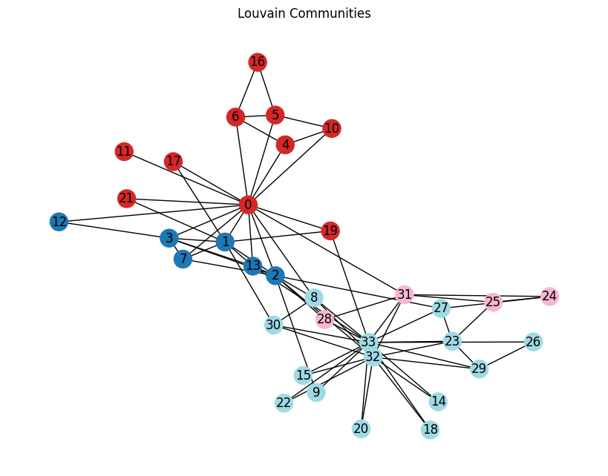
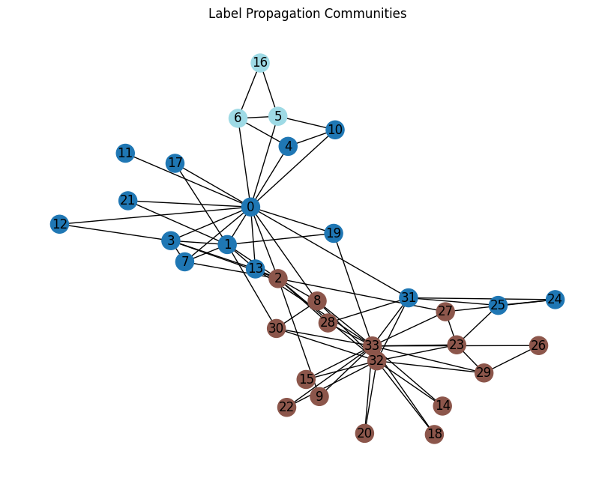
Graphs of Louvain & Label Propagation
(as outputted by our code)

Slide 12
Real-World Applications (Louvain)
Social Network Analysis
Connects social groups of people based on common interests
Detects communities of users that live in the same area via graphs and patterns
Common examples are apps such as Instagram, Snapchat, Facebook, Twitter (X)
Customer Transactions
Identifies customers with similar spending habits
Displays advertisements for targeted customers
Common examples include stores such as Target, Walmart, Publix, Best Buy

Slide 13
Real-World Applications (Label Propagation)
Streaming Services
New features are added after more and more users join
Communities are quickly updating after adding new graph data
Common examples are apps such as Spotify, iTunes, Netflix, YouTube, TikTok
Spam/Bot Detection
Accounts are quickly grouped together based on similar spam activity
Bots often repost the same content as others
Common examples include Twitter bots, Discord graphic artists, Instagram spam comments, and spam email messages

Slide 14
Conclusion
Based on our results, the Louvain algorithm ended up being more effective than Label Propagation for the Karate Club dataset. As displayed by our code and its outputs, Louvain had a well-spread community structure, higher modularity, and higher NMI and ARI scores. Despite Label Propagation having a faster runtime, there was uneven clustering and less stability in presenting the true network structure.
Both Louvain and Label Propagation are still community detection algorithms that are universally applied in real-world data mining today. However, for this given dataset, Louvain was proven to be the more reliable algorithm of the two.

